Slide 1
Integration of Information Models and Tools Project
1
2017Q1 Status
Informational Brief
HL7 Project Scope Statement (PSS)
For Achieving Computable Interoperability with an
HL7/ISO “Common Logical Information Model (CLIM)”
Prepared for
Stakeholders and Proponents
ONC, FHA, IPO, DoD, VA, FDA, SAMHSA, CDC & External Partner SMEs
Prepared by
Steve Wagner (FHIM), Julia Skapik (CQI), Keith Campbell (SOLOR),
Stan Huff (CIMI), Nona Hall and Steve Hufnagel (IIM&T Facilitators)
March 7, 2017 DRAFT
HL7 IIM&T Project intends to result in clear, complete, concise, correct, consistent and traceable standards and
Easy-to-use FHIR-CDA-NIEM implementation artifacts for Federal Agencies and their partners, venders and integrators

Slide 2
Roadmap
2
Stan Huff
CIMI
ONC, FHA,
DoD, VA, IPO,
FHIM (Wed, Fri)
FDA, CDC
HL7 CIMI (Thu)
Julia Skapik
CQI & CDS
Core SMEs
Organizations
Meetings
HL7, ISO
SOLOR (Tue)
Steve Wagner
FHIM
HSPC
HL7 Working Groups
Keith Campbell
SOLOR
Open Group
HSPC Meetings
HL7 IIM&T Project
HL7-ISO Standards,
Tools and Training
FHIM
FHIM – CIMI Harmonization
IPO Technical Forum
2017-01 HL7 Comment-only Ballot
2017-05 HL7 Informative Standard
2017-09 HL7 Trial Use Standards
2018-09 HL7 Trial Use Standards
2019-09 HL7 Normative Standard
2020-09 HL7-ISO Standard
CIMI
FHIR US Core /
QI Core Integration
FHA Managing Board
CQI
Newsletters
Models and Tools
Projects
Communications
SOLOR
CDS
Pediatric Bilirubin
SIGG
ONC – FHIR
Modeling Meetings
Device interfaces MDEpiNet
FHIR
HL7 & ISO Ballot &
Standards Reviews
Others
Skin Wound Assessment
HL7 IIM&T Project intends to result in clear, complete, concise, correct, consistent and traceable standards and
Easy-to-use FHIR-CDA-NIEM implementation artifacts for Federal Agencies and their partners, venders and integrators

Slide 3
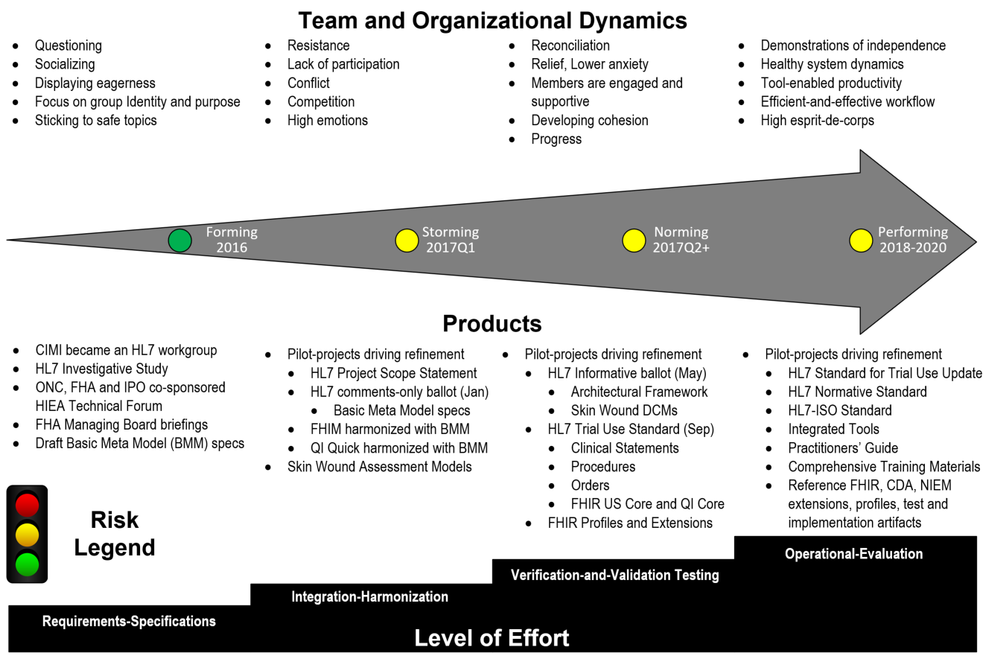
2017Q1 Status Schedule is at risk under current resourcing FHIM, SOLOR, CQI, CIMI, SIGG Projects and SMEs need sustained resourcing
3
HL7 IIM&T Project intends to result in clear, complete, concise, correct, consistent and traceable standards and
Easy-to-use FHIR-CDA-NIEM implementation artifacts for Federal Agencies and their partners, venders and integrators

Slide 4
2017Q1 Pilot-Projects Status
4
Collaboration Pilot-Projects (2017Q1); where, #1, #2, #3 indicate May-2017 Ballot inclusion-priority:
FHIM integration of CIMI Clinical BMM & Archetypes (Patterns) #1 [Galen Mulrooney]
US Core / QI Core integration of CIMI BMM & Archetypes (Patterns) #1 [Claude Nanjo]
Refine PROCEDURE and CONTEXT based on Pilots #1 (Galen Mulrooney and Claude Nanjo)
Patient Care Project #1253 "CIMI Clinical Model Proof of Concept" (Skin Wound Assessment) #1
Pediatric Bilirubin Management CDS #2, needs code generation library [Ken Kawamoto]
Zika measure #3 [Ken Kawamoto and Claude Nanjo]
Immunization Management EHR Functional Model Profile #3 (Steve Hufnagel and Gary Dickinson)
Family Planning Annual Report (FPAR) – HSPC pilot with ACOG #3 [Stan Huff, Susan Matney]
Device interfaces MDEpiNet. #3 [Julia Skapik, ONC and Terri Reed, FDA]
FHIR JET (Joint Exploratory Team) #3 Nona Hall, IPO, VA, DoD
HL7 IIM&T Project intends to result in clear, complete, concise, correct, consistent and traceable standards and
Easy-to-use FHIR-CDA-NIEM implementation artifacts for Federal Agencies and their partners, venders and integrators

Slide 5
Acknowledgement Collaboration that Grows with a Strong SME Base
5
CIMI Co-Chairs
Linda Bird BIT, IHTSDO
Galen Mulrooney, FHA and VA contractor
Richard Esmond, PenRad LLC
Stanley Huff, Intermountain Healthcare
Members of the following SDOs
IHTSDO, POC: Linda Bird BIT
HL7 Work Groups (CBCC, CIC, CDS, CQI, DEV, EHR, FMG, HSI, SOA, Vocab)
The Open Group Healthcare Forum, Jason Lee POC
ISO/CEN, POCs: Gerard Freriks, William Goossen, Gary Dickinson
Federal Agency staff and contractors
Department of Defense, Veterans Administration, Interagency Program Office
Federal Drug Agency, Center for Disease Control, SAMHSA
ONC OST and Federal Health Architecture
Apprio Inc., Cognitive Medicine, Iris Health Solutions LLC, JPSystems, MITRE
Members of the following Healthcare Organizations
Intermountain Healthcare, Mayo, PenRad, Inc., Results4Care
Health Services Platform Consortium (HSPC),
American College of Gynecology (ACOG)
Faculty, Staff and Students
Duke University, The University of Utah
HL7 IIM&T Project intends to result in clear, complete, concise, correct, consistent and traceable standards and
Easy-to-use FHIR-CDA-NIEM implementation artifacts for Federal Agencies and their partners, venders and integrators
Notes:
Stakeholders:
Nancy
Bart
Jan Edwards
Tom Hokel
Keith Campbell
Ken Rubin
Bob Bishop
Gail Masik
Rene Kinsey

Slide 6
Back Up Slides
Project Information - Related Links
Approach
IT Objective
“About Project” Slides:
Acronyms

Slide 7
Project Information – Related Links
7
Supporting documents are viewable and downloadable at
HL7 IIM&T Project Scope Statements https://1drv.ms/f/s!AlkpZJej6nh_lIQOuPJcL2rf5BVoXQ
IIM&T Technical Forum Summary https://1drv.ms/w/s!AlkpZJej6nh_k9gyRVADgOvM5SlJkQ
IIM&T Work Breakdown Structure https://1drv.ms/f/s!AlkpZJej6nh_lKc00J3Kh2BTkopPnA
IIM&T Practitioners’ Guide http://wiki.hl7.org/index.php?title=CIMI_Practitioners%27_Guide
IIM&T Briefing Slides https://1drv.ms/f/s!AlkpZJej6nh_lIQQVk9-KW1PFVOXdQ
IIM&T Newsletters https://1drv.ms/f/s!AlkpZJej6nh_k-RIHMWezhAd7fONHg
IIM&T Reports https://1drv.ms/f/s!AlkpZJej6nh_lIQSMLOHY-XGGUOSxg
FHIM Artifacts http://fhims.org
CIMI Minutes http://wiki.hl7.org/index.php?title=CIMI_Minutes
CIMI Wiki http://wiki.hl7.org/index.php?title=Clinical_Information_Modeling_Initiative_Work_Group
CIMI Modeling Architecture, Methodology and Style Guides http://wiki.hl7.org/index.php?title=CIMI_Modeling,_Architecture,_Methodology_and_Style_Guides
Questions?
Contact Facilitators at:
Nona.G.Hall.civ@mail.mil
Stephen.Hufnagel@ApprioInc.com
Note that many networks block the use of clickable links; where,
You must copy the link into a browser to access the content.
If links don’t work on a Government Network or VPN, try accessing them directly (without VPN)
Backup

Slide 8
Approach
Our clinical goal is to help people live the healthiest lives possible by enabling a “Learning Health System” supporting areas such as, but not limited to, Precision Medicine, Clinical Decision Support, Genomics, Research, etc.
This requires data that is computable, usable, extensible, and interpretable across disparate systems - a state that currently does not exist
The proposed solution capitalizes on the inroads made with the exchange of data, standards and standards adoption, but brings back a focus on the data in order to make additional and necessary advancements
.

Slide 9
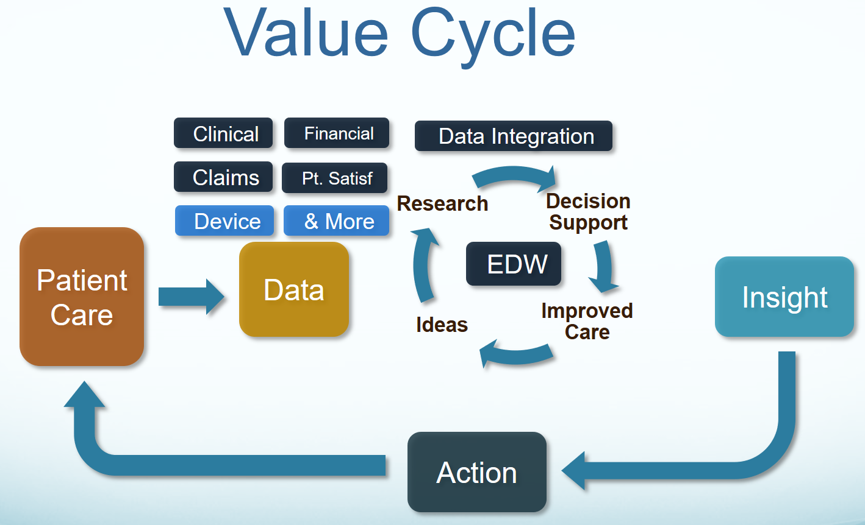
IT Objective
9
Our IT objective is to make the appropriate data available
when it is needed, where it is needed and how it is needed.
HL7 IIM&T Project intends to result in clear, complete, concise, correct, consistent and traceable standards and
Easy-to-use FHIR-CDA-NIEM implementation artifacts for Federal Agencies and their partners, venders and integrators

Slide 10

10
Problem: Skyscraper Analogy
As-Is
To-Be
Not Harmonized
Not Harmonized
Harmonized
Shared Meaning
No shared terminology model or information model - not interoperable
No shared terminology model, shared information model - not interoperable
Shared terminology model and information model - interoperable future state
*Drawn from Dr. Keith Campbell’s analogy used within The Open Group Healthcare Forum (HCF) article:
Advancing Healthcare Interoperability www.opengroup.org/bookstore/catalog/w16a.htm
See Notes Page
HL7 IIM&T Project intends to result in clear, complete, concise, correct, consistent and traceable standards and
Easy-to-use FHIR-CDA-NIEM implementation artifacts for Federal Agencies and their partners, venders and integrators
Notes:
BLUF (Bottom Line Up Front)
As is: no shared terminology content (floor 1), no shared information models (floor 2), then they are building from the 3rd floor up. No shared value from the 3rd floor up.
Future State: shared terminology content (floor 1), shared information models (floor 2), sharable value built on floors above.
In a perfect world the following would be done concurrently and with close collaboration
Recommended Solution Part 1: We integrate SOLOR into FHIM
Concurrently, resolving SOLAR gaps
Recommended Solution Part 2: We integrate CIMI, FHIM and CQF
Recommended Solution Part 3: We follow Agile refinement cycles through pilots and implementations
Recommended Solution Part : We develop adequate documentation, test cases, fixtures and supporting resources
In the real world, we are asking:
the Federal Partners to provide resources to make efficient and effective progress in the near, mid and long term.
the Federal Partners to work together to deliver—in an ongoing way—a single integrated terminology system (SOLOR), that meets all US regulatory requirements, while simplifying implementation for developers.
the FHA to facilitate Federal Partner governance and configuration management of this work
This ONC OTS to endorse this initiative and facility resources
We are asking the IPO to provide coordination and facilitation
We are asking HL7 to facilitate
international, commercial and academic peer review and
ballot governance and configuration management.
Coordination of an ISO ballot (this will be several years from now)
Analogy of the Challenge: Today’s efforts occur as if we’re always trying to build the ultimate skyscraper, starting on the 3rd Floor.
Inconsistencies exist/become extended producing transformational (mapping) efforts = models, models everywhere
The problem is that today’s healthcare systems do not capture information and its context consistently, and consequently, they cannot easily share-or-merge information from different sources to create a computable operational-picture (aka longitudinal patient-records, care plans, clinical knowledge and other shared healthcare information across time, multiple care locations and differing contexts).
If continued and unchecked, even the best of implementation accelerators, like FHIR with its extensions and profiles, allow far too much implementation variation; where, each project often creates, from scratch, yet, another information model, e.g. through a mapping exercise.
The missed opportunity is to leverage a shared logical Reference Information Model minimizing the duplicative-work, avoiding inconsistencies and avoiding the necessity to engage these SMEs, these resources and our larger community. This is the “models, models everywhere phenomenon ”. As an example,
Standards, in general, use different formats and rules for ‘simple’ things like: name, address, dates. Resulting in EHR-systems that after decades cannot uniformly exchange this ‘simple’ ubiquitous data; let alone ‘complex’ clinical health data.
the HL7 EHR Interoperability workgroup, in its analysis “Record Entry Lifecycle Event Metadata using FHIR,” found substantial provenance (who, what, when, where and how) inconsistencies among FHIR resources .
http://wiki.hl7.org/index.php?title=EHR_Interoperability_WG
The SOLOR/LEGO team found FHIR tries to define things such as attributes for anatomy, that are not based on a particular model of anatomy, and thus you get semantic overlap, with the burden of reconciliation, which may not even be possible, if left to the end user.

Slide 11


Proposed Solution: Integration of Information Models Enabled by Tools
11
KNART
KNART
KNART
DCM
DCM
DCM
DCM
DCM
CQI
C QF
CDS
DCM
DCM
Other
Initiatives
DCM
CIMI
FHIM
DCM
DCM
DCM - Detailed Clinical Models
FHIM – Federal Health Information Model
KNARTS – Knowledge Artifact
SOLOR – SNOMED, LOINC, RxNorm
SOLOR
See Notes Page

Slide 12
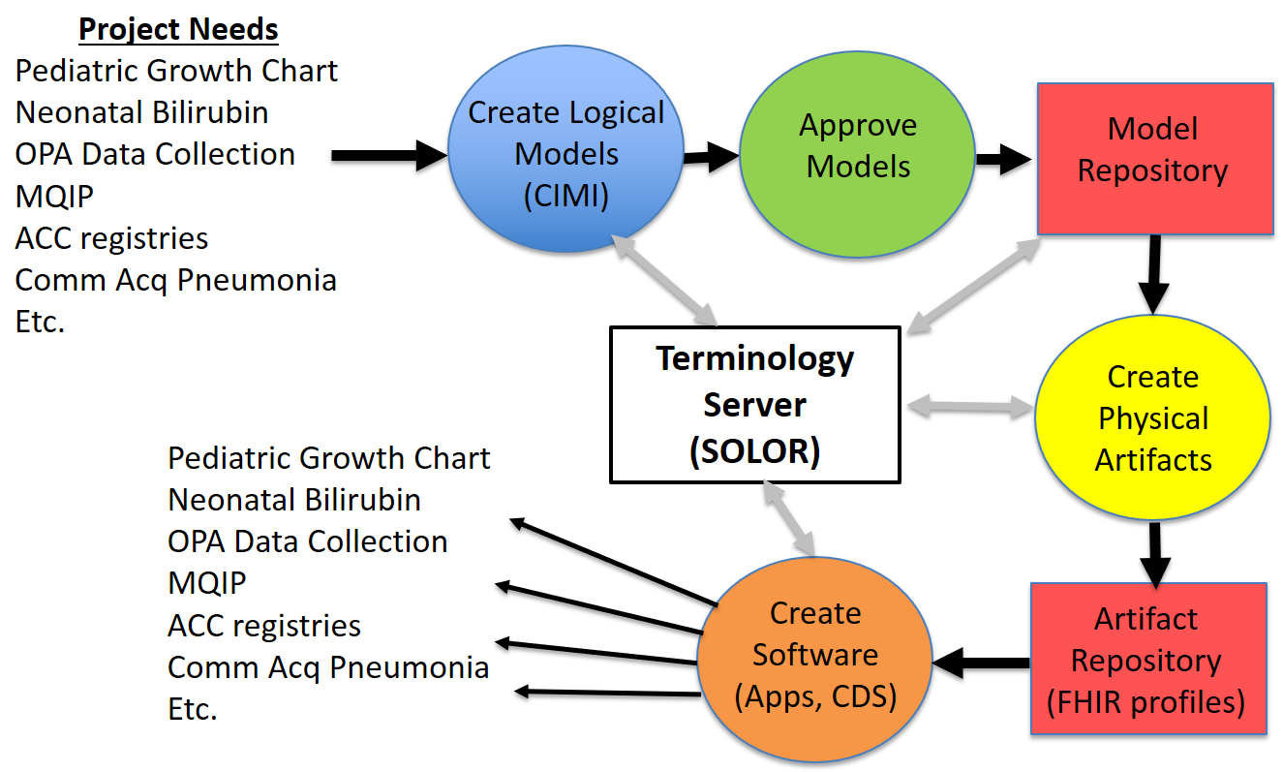

Better Implementation Products: Apps Based on Integrated/Reusable Models
12
CLIM
{SOLOR, FHIM, CIMI, CQF, …}
CLIM
(HL7/ISO
Balloted
Version)
ACC is American College of Cardiologists, COMM Acq is Community-acquired,
MQIP is Medicare Quality Improvement Program, OPA is Oropharyngeal Airway

Slide 13
Health IT Goal and Methodology Computable Semantic-Interoperability
13
FHIM, using SMEs,
Standards,
US Regulatory Requirements
CQI, using SMEs,
CQF, vMR & QDM
Requirements
CIMI, using SMEs,
FHIM & CQI
Domain Models
CIMI Principles & Reference Models
CIMI Principles & Reference Models
CIMI Principles & Reference Models
FHIM
Domain Models
QI Quick & DAF
Domain Models
CIMI DCMs
CQI eCQMs
CDS KNARTs
Common Stakeholders
SOLOR Terminology Editor
SNOMED CT, LOINC and RxNorm Semantics
VSAC Terminology Server
Manual or using Tools
Manual or using Tools
Manual or using Tools
Interoperability Specifications and Implementation Artifacts
CDA, NIEM, FHIR (US Core, QI Core, Profiles, Extensions)
HL7 IIM&T Project intends to result in clear, complete, concise, correct, consistent and traceable standards and
Easy-to-use FHIR-CDA-NIEM implementation artifacts for Federal Agencies and their partners, venders and integrators

Slide 14
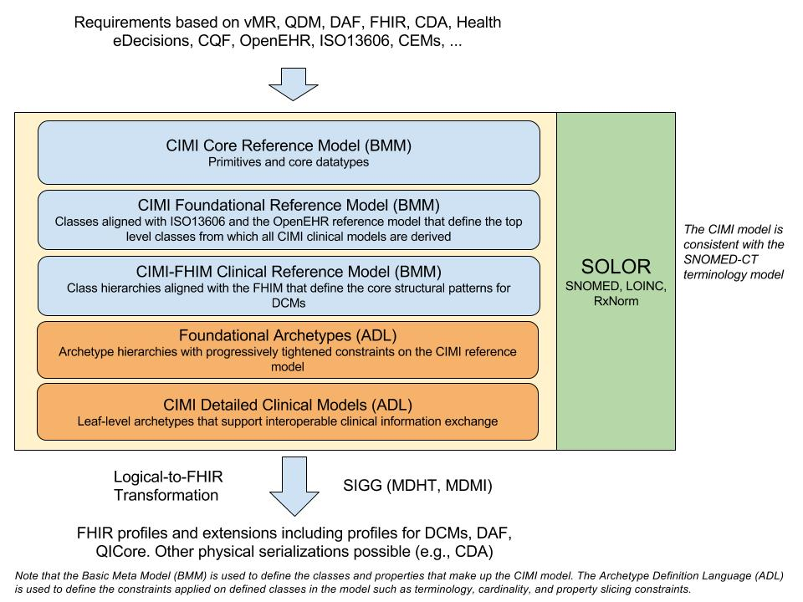
CIMI Architectural Framework
14
See Notes Page
HL7 IIM&T Project intends to result in clear, complete, concise, correct, consistent and traceable standards and
Easy-to-use FHIR-CDA-NIEM implementation artifacts for Federal Agencies and their partners, venders and integrators
See Notes Page
Notes:
The CIMI Architectural Framework (AF) is expressed using the OpenEHR Basic Metamodel (BMM) UML. The archetype layers are expressed using the OpenEHR Archetype Definition Language (ADL). While reference model modules define classes, attributes, and class hierarchies, the archetype layers only specify progressive constraints on the reference model but do not introduce new classes, attributes, and class-class relationships.
The CIMI Core Reference Model provides the core granularity of the CIMI model and introduces its top-level classes such as the DATA_VALUE class and the LOCATABLE class. This reference layer module defines the CIMI primitive types and core data types.
The CIMI Foundational Reference Model is closely aligned to ISO13606 and the OpenEHR Core Reference Model. It defines foundational CIMI clinical documents and clinical record patterns. It also introduces the PARTY, ROLE, and PARTY_RELATIONSHIP patterns and defines the top-level CLUSTER class for complex CIMI type hierarchies. CQI Knowledge Artifacts may also leverage this layer.
The CIMI Clinical Reference Model consists of the classes derived from existing CIMI archetypes, the FHIM, QUICK, vMR, and QDM. This layer defines the set of 'schematic anchors' (to borrow Richard Esmond's term) or core reference model patterns from which all CIMI archetype hierarchies and ultimately Detailed Clinical Models (DCMs) derive. Requirements for this layer come from FHIM, vMR, QDM, QUICK, FHIR US Core, SDC, etc...
The goal is to define the reference models with low FHIR transformation costs where feasible noting that we will inherently have some divergence due to the different requirements underlying both models.
Galen points out that, FHIM’s expressivity will not carry over to CIMI DCMs given the models' different requirements (e.g., FHIM includes finance and accounting).
The CIMI Foundational Archetypes define the top-level constraints on the CIMI Reference Model. These typically consist of attribute formal documentation and high level attribute semantic and value set bindings. Archetypes at this layer will provide the foundational requirements for future US Core and QI Core profiles. Future pilots will explore the generation of US Core and QI Core archetypes from these CIMI archetypes.
The CIMI Detailed Clinical Model Layer represents the set of leaf-level constraining profiles on the foundational archetypes to create families of archetypes that only vary in their finest terminology bindings and cardinality constraints. This layer is intended to support clinical interoperability through an unambiguous specification of model constraints for information exchange, information retrieval, and data processing.
From layers 1-5, we define the set of transformations (e.g., SIGG (MDHT, MDMI)) to generate the corresponding FHIR profiles including the US Core and QI Core profile sets. Note that FHIR profiles can be generated from the various levels of the archetype hierarchy depending on requirements. The lower down in the hierarchy, the more prescriptive the profile is in terms of constraints. Much the CIMI AF, FHIR profiles can be layered.

Slide 15
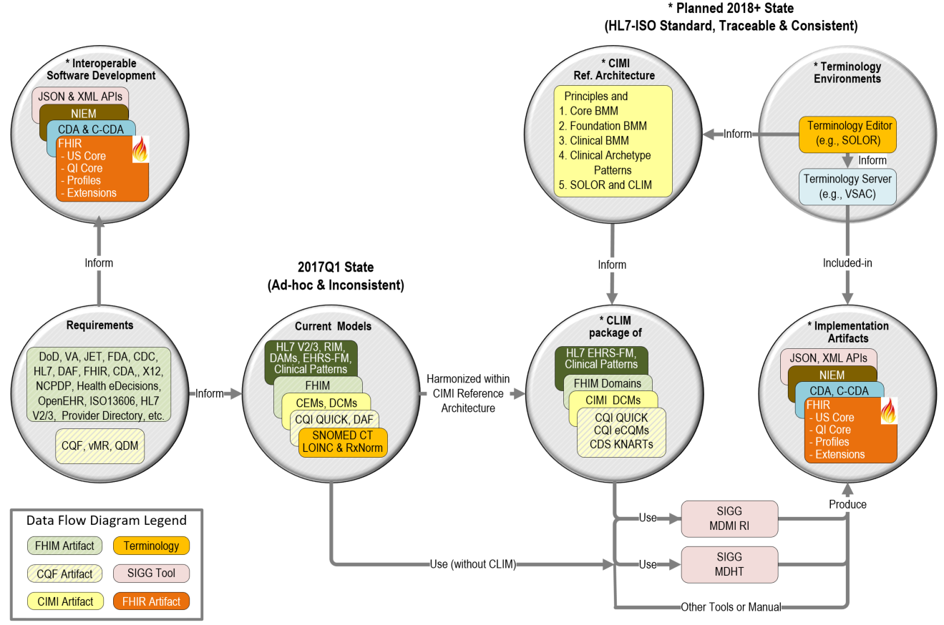
Strategy Collaboration of government, industry and academic SMEs where, hope is not a strategy, luck is not a factor and ignorance is not bliss
15
See Notes Page
HL7 IIM&T Project intends to result in clear, complete, concise, correct, consistent and traceable standards and
Easy-to-use FHIR-CDA-NIEM implementation artifacts for Federal Agencies and their partners, venders and integrators
Notes:
Integration and interoperability tool-strategy supporting CLIM maintenance at HL7 and use by vendors, developers and implementers
Non-integrated tools and ultimately SIGG have the potential to go directly from FHIM, QI Quick and other domain models (financial, logistics, etc.) to FHIR Structure Definitions and is under consideration and evaluation; where,
FHIR Structure Definitions can be used to describe the underlying resources, data types, terminology bindings and value sets used to specify FHIR and its extensions and profiles.
This approach does not require ADL Architypes constraint specifications; this can help because, ADL is not taught and is not commonly used in the US Realm.
Additional resources are needed to develop (clinical analysts’ user interfaces, MDMI, MDHT upgrades), test and properly document for ease-of-use by non-modelers, non-informaticists and non-engineers.
The benefit of having the FHIR extension and prototype process contained in one easy-to-use model-driven-development tool, such as SIGG, is the ability for clinical analysts to maintain clear, complete, concise, correct, consistent and traceable standards & implementation artifacts, which are easy-to-use by Federal Agencies and their partners, venders and integrators.

Slide 16
FHIM Status To be updated by Galen & Jay
Class Modeling
Domains-completed, being-updated and in-progress
Terminology Modeling
Domains-completed, being-updated and in-progress
CIMI-FHIM Harmonization
2-of-3 refactoring (s) done (Provenance, Patient, topic-context → 9 mo-70% on “infrastructure” ) 26 Mar HL7 deadline
Clinical domains refactoring
Clinical Statements, Observations, Encounters, lab, pharmacy patterns in-progress
Actions-Procedures TBD (with Claude Nanjo)
FHIR’s STU3 re-harmonization TBD
Security-Privacy FHIM re-harmonization TBD (with Robert Crawford)
End State
Model Driven Development of Enhanced FHIR Resources (Extensions and Profiles)
HL7 IIM&T Project intends to result in clear, complete, concise, correct, consistent and traceable standards and
Easy-to-use FHIR-CDA-NIEM implementation artifacts for Federal Agencies and their partners, venders and integrators

Slide 17
CIMI Architectural Framework Talking Points
17
The CIMI Architectural Framework (AF) is expressed using the OpenEHR Basic Metamodel (BMM) UML. The archetype layers are expressed using the OpenEHR Archetype Definition Language (ADL). While reference model modules define classes, attributes, and class hierarchies, the archetype layers only specify progressive constraints on the reference model but do not introduce new classes, attributes, and class-class relationships.
The CIMI Core Reference Model provides the core granularity of the CIMI model and introduces its top-level classes such as the DATA_VALUE class and the LOCATABLE class. This reference layer module defines the CIMI primitive types and core data types.
The CIMI Foundational Reference Model is closely aligned to ISO13606 and the OpenEHR Core Reference Model. It defines foundational CIMI clinical documents and clinical record patterns. It also introduces the PARTY, ROLE, and PARTY_RELATIONSHIP patterns and defines the top-level CLUSTER class for complex CIMI type hierarchies. CQI Knowledge Artifacts may also leverage this layer.
The CIMI Clinical Reference Model consists of the classes derived from existing CIMI archetypes, the FHIM, QUICK, vMR, and QDM. This layer defines the set of 'schematic anchors' (to borrow Richard Esmond's term) or core reference model patterns from which all CIMI archetype hierarchies and ultimately Detailed Clinical Models (DCMs) derive. Requirements for this layer come from FHIM, vMR, QDM, QUICK, FHIR US Core, SDC, etc...
The goal is to define the reference models with low FHIR transformation costs where feasible noting that we will inherently have some divergence due to the different requirements underlying both models.
FHIM’s expressivity will not carry over to CIMI DCMs given the models' different requirements (e.g., FHIM includes finance and accounting).
The CIMI Foundational Archetypes define the top-level constraints on the CIMI Reference Model. These typically consist of attribute formal documentation and high level attribute semantic and value set bindings. Archetypes at this layer will provide the foundational requirements for future US Core and QI Core profiles. Future pilots will explore the generation of US Core and QI Core archetypes from these CIMI archetypes.
The CIMI Detailed Clinical Model Layer represents the set of leaf-level constraining profiles on the foundational archetypes to create families of archetypes that only vary in their finest terminology bindings and cardinality constraints. This layer is intended to support clinical interoperability through an unambiguous specification of model constraints for information exchange, information retrieval, and data processing.
From layers 1-5, we define the set of transformations (e.g., SIGG (MDHT, MDMI)) to generate the corresponding FHIR profiles including the US Core and QI Core profile sets. Note that FHIR profiles can be generated from the various levels of the archetype hierarchy depending on requirements. The lower down in the hierarchy, the more prescriptive the profile is in terms of constraints. Much like the CIMI AF, FHIR profiles can be layered.
HL7 IIM&T Project intends to result in clear, complete, concise, correct, consistent and traceable standards and
Easy-to-use FHIR-CDA-NIEM implementation artifacts for Federal Agencies and their partners, venders and integrators

Slide 18
Tool-Strategy Talking Points
18
Non-integrated tools and ultimately SIGG have the potential to go directly from FHIM, QI Quick and other domain models (financial, logistics, etc.) to FHIR Structure Definitions and is under consideration and evaluation; where,
FHIR Structure Definitions can be used to describe the underlying resources, data types, terminology bindings and value sets used to specify FHIR and its extensions and profiles.
This approach does not require ADL Architypes constraint specifications; this can help because, ADL is not taught and is not commonly used in the US Realm.
Additional resources are needed to develop (clinical analysts’ user interfaces, MDMI, MDHT upgrades), test and properly document for ease-of-use by non-modelers, non-informaticists and non-engineers.
The benefit of having the FHIR extension and prototype process contained in one easy-to-use model-driven-development tool, such as SIGG, is the ability for clinical analysts to maintain clear, complete, concise, correct, consistent and traceable standards & implementation artifacts, which are easy-to-use by Federal Agencies and their partners, venders and integrators.
HL7 IIM&T Project intends to result in clear, complete, concise, correct, consistent and traceable standards and
Easy-to-use FHIR-CDA-NIEM implementation artifacts for Federal Agencies and their partners, venders and integrators

Slide 19
Acronyms
19
BMM | CIMI Basic Meta Model components | ISAAC | VA tool for SOLOR
CEM | Intermountain Clinical Element Models | ISO | International Standards Organization
CIMI | HL7 Clinical Information Model Initiative | JIF | VA/DOD Joint Incentive Fund
CQI | HL7 Clinical Quality Information | KNART | CDS Knowledge Artifact
CQF | HL7 Clinical Quality Framework | LOINC | Logical Observation Identifiers Names and Codes
CLIM | HL7 Clinical Logical Information Model | MDHT | Model Driven Health Tools
DAF | ONC Data Access Framework | MDMI | Model Driven Message Interoperability
DCM | Detailed Clinical Model | ONC/OST | US Office of the Natl. Coordinator / Office of Science and Tech.
eCQM | CQI Electronic Clinical Quality Measure | PMP | Program Management Plan
STU | HL7 Standard for Trial Use | PSS | Project Scope Statement
EDW | Electronic Data Warehouse | QUICK | CQI Quality Information and Clinical Knowledge logical model.
FDA | US Federal Drug Agency | RXNORM | US National Library of Medicine naming system for drugs
FHA | US Federal Health Architecture | SIGG | Standards Interoperability Guide Generator
FHIM | US Federal Health Information Model | SOLOR | SNOMED extension for LOINC & RXNorm
FHIR | HL7 Fast Health Information Resource | TLC | ONC/OST Technical Learning Center
HIEA | DoD VA IPO Health Interoperability Exchange Alliance | VA | US Veterans Administration
HcDir | ONC-FHA Provider Healthcare Directory. | VCS | Version Control System for collaboration
IPO | US DoD and VA Interagency Program Office | VSAC | NLM Value Set Authority
See Notes Page
Notes:
BMM is CIMI Basic Meta Model components See http://wiki.hl7.org/index.php?title=CIMI_Practitioners%27_Guide
CDA is HL7 Clinical Data Architecture. See http://www.hl7.org/implement/standards/product_brief.cfm?product_id=258
C-CDA is HL7 Consolidated CDA. See http://www.hl7.org/implement/standards/product_brief.cfm?product_id=379
CEM is Intermountain Clinical Element Models e http://www.opencem.org/#/
CDS is HL7 Clinical Decision Support workgroup. See http://wiki.hl7.org/index.php?title=Clinical_Decision_Support
CIMI is HL7 Clinical Information Model Initiative. See http://wiki.hl7.org/index.php?title=Clinical_Information_Modeling_Initiative_Work_Group
CIMI Principles See http://wiki.hl7.org/index.php?title=CIMI_Practitioners%27_Guide
CIMI Reference Models (aka Information Architecture) See http://wiki.hl7.org/index.php?title=CIMI_Practitioners%27_Guide
CLIM is HL7 Clinical Logical Information Model Package of CIMI-Harmonized SOLOR, FHIM, CQF, CIMI DCMs and CQI KNARTs
where, independent organizations maintain the component models and HL7 periodically configuration manages, ballots and standardizes them.
CQF is ONC Clinical Quality Framework. See http://wiki.hl7.org/index.php?title=Clinical_Decision_Support
CQI is HL7 Clinical Quality Information workgroup. See http://wiki.hl7.org/index.php?title=Clinical_Quality_Information
DAF is ONC Data Access Framework (US Core). See http://wiki.siframework.org/Data+Access+Framework+Homepage
DCM is CIMI Detailed Clinical Models. See http://www.opencimi.org/model-browser
eCQM is Electronic Clinical Quality Measure
FHIM is Federal Health Information Model; where, FHIM specifies healthcare domains and their data modules and their data elements. http://FHIMS.org
FHIR is HL7 Fast Healthcare Information Resource standard and workgroup. See http://wiki.hl7.org/index.php?title=FHIR
HcDir is ONC-FHA Provider Healthcare Directory. See http://wiki.siframework.org/Provider+Directories
IIM&T Is CIMI-sponsored HL7 Integration of Information Models & Tools Project. http://wiki.hl7.org/index.php?title=CIMI_Practitioners%27_Guide
JET is DoD-VA Joint Exploratory Team.
KNART is CDS Knowledge Artifact. See http://www.hl7.org/implement/standards/product_brief.cfm?product_id=337
MDHT is SIGG Model Driven Health Tool. See https://projects.eclipse.org/proposals/model-driven-health-tools
MDMI is SIGG Model Driven Message Interoperability.
The present MDMI Referent Index (RI) scope is the US Core; where, FHIM is used for data-element value-sets.
FHA’s MDMI RI supports all MU2 data elements and >90% of the C-CDA model.
See http://www.omg.org/mdmi/ and http://www.omg.org/spec/MDMI/ and https://github.com/MDMI/ReferentIndexContent
NIEM is National Information Exchange Package. It provides browser-cased “interoperability” among Federal agencies. See https://www.niem.gov/
QI Core is FHIR Quality Improvement Core Implementation Guide . See https://www.hl7.org/fhir/qicore/qicore.html
QUICK is CQI Quality Information and Clinical Knowledge logical model.
See https://www.hl7.org/documentcenter/public_temp_315E0F18-1C23-BA17-0C73398BA144AB5D/wg/cqi/Defining_eCQMs_Using_CQL.pdf
RI is SIGG-MDMI Referent Index. See https://github.com/MDMI/ReferentIndexContent
SIGG is FHA Standards Implementation Guide Generator
SOLOR is VA’s SnOmed LOinc, Rxnorm; where, HSPC hosts the SOLOR project to provide the terminology foundation for model development.
VSAC is NLM Value Set Authority Center. https://vsac.nlm.nih.gov/

